Slide 1
Earth Observation Exploitation Platform Hackathon 2018
March 2018
Dr. Ingo Simonis
Open Geospatial Consortium

Slide 2
Agenda
13:30 – 13:45
Patent call, introduction, admin
13:45 – 14:05
What do we want to do?
14:05 – 14:25
Application, clouds
14:25 – 15:00 discussion

Slide 3
Why we are here today?
Sponsored by ESA and NRCan
Idea developed at the Testbed-13 Final Demonstration Meeting
Evaluate if the Testbed-13 Earth Observation Clouds (EOC) results work in practice

Slide 4
Admin
PA: Reduced to single page
Most importantly: Patent call

Slide 5
Patent Call
Please be aware that this initiative is being conducted under the OGC Policy Regarding Intellectual Property Rights (available at http://www.opengeospatial.org/about/ipr).
At this time, I would ask that anyone in attendance inform me if they are personally aware of any claims under any patent applications or issued patents that would be likely to be infringed by an implementation of the standard or other work product which is the subject of this initiative.
You need not be the inventor of such patent or patent application in order to inform us of its existence, nor will you be held responsible for expressing a belief that turns out to be inaccurate.

Slide 6
Who is who and why are you here
30sec each ☺

Slide 7
Admin
PA: Reduced to single page and to “Feedback Agreement”
Cost compensation: EUR 4k lump sum, purchase order, details soon
Participation at the final demo meeting May 3-4 in Darmstadt is obligatory
Some emails, but very few phone conferences
Github at https://github.com/opengeospatial/EOEPHackathon2018
AWS resources:
https://aws.amazon.com/earth/research-credits/
cloud@opengeospatial.org

Slide 8
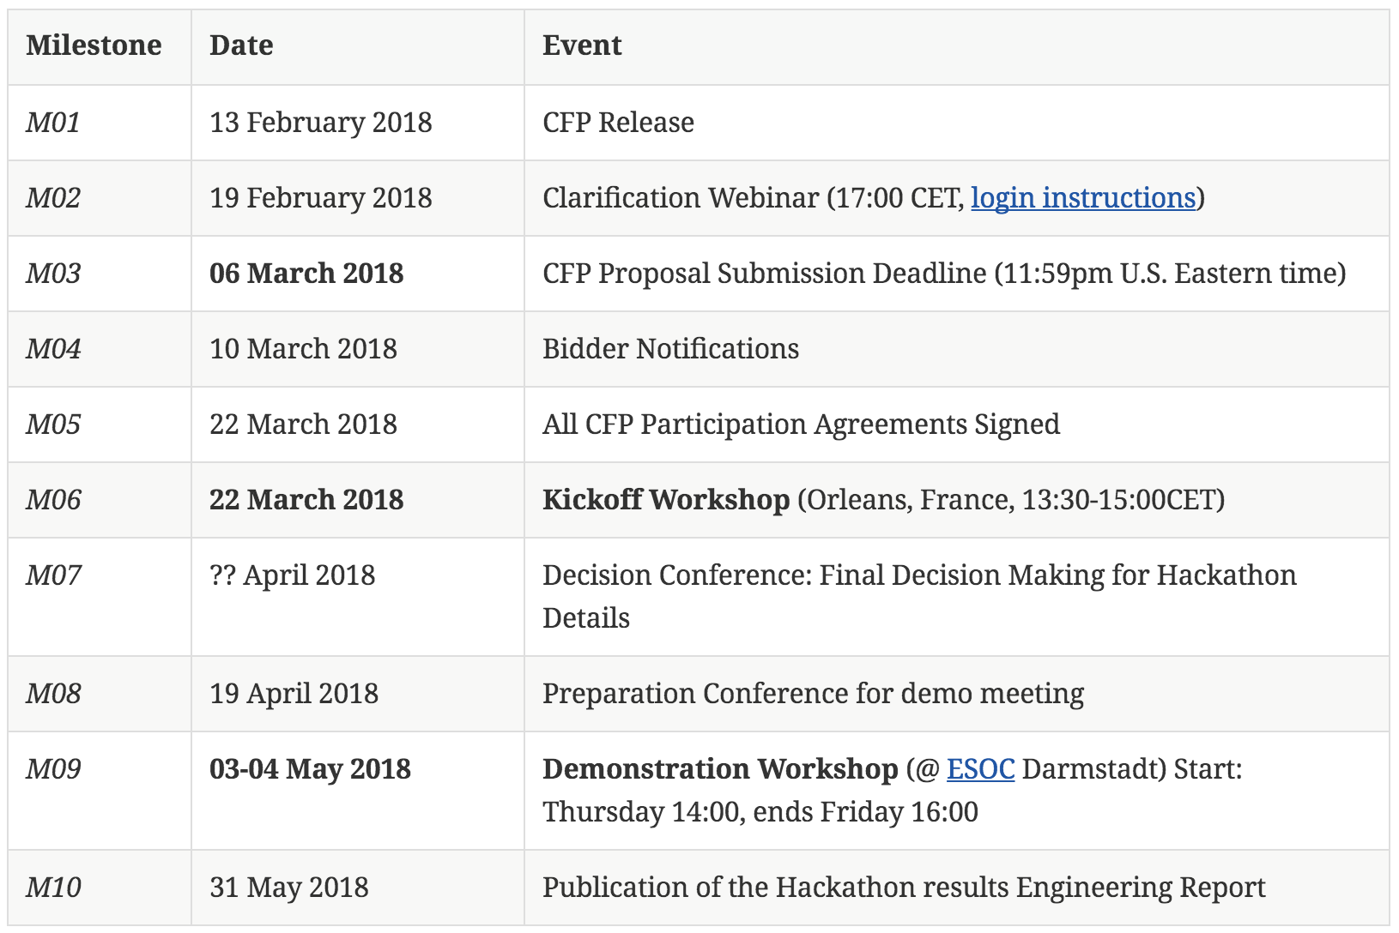
Master Schedule

Slide 9
Application
developer
Application
consumer
Notes:
Typical situation: on the one side is the application developer, who creates an application, on the other side is the consumer.
How can the developer make the application available in the cloud so that the consumer can use it?

Slide 10
Dynamic registration of
new apps
Application
developer
Minimize effort for app developer
Consumers use their
own data
Dynamic scaling of
cloud environment
Application
consumer
Results at
OGC Web services
Notes:
T13 requirements

Slide 11
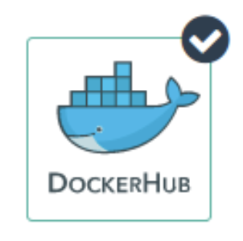


1
Application
developer
5
2
Application
consumer
3
6
4
Notes:
6th step: application consumer provides all execution information to the application platform

Slide 12
Application
developer
IAAS
AWS
WPS
WPS
IPT Poland
WFS
CSW
WCS
WMS
Application
consumer
Notes:
Let’s change to a more schematic perspective: Here we see that a number of OGC Web services are deployed.
The left WPS manages all the application packages, whereas the right one deploys requested containers in the cloud and executes them.
Data can be accessed through standard OGC data access services.

Slide 13
Future Work
Application Builder
Wizard to build the OWS Context document
Wizard to Dockerize application
Standardized and standardized handling of output data
Application Deployment & Execution
More info about application in AP, e.g. infrastructure resource requirements, parallelization options etc.
Test more complex applications, e.g. multi-cloud
Security
Bulk windowed execution, continuous periodic generation
Quotes, accounting/billing

Slide 14
What we want to do -1
Canada’s forest cover an area of 348 million hectares, which is 35% of Canada’s land area and 9% of the world’s forested area.
Because vast areas are inaccessible, researchers use satellites such as Sentinel-1 to gain valuable insights into Canada’s forest ecosystem.
The Hackathon shall evaluate the extent of wild fires based on Sentinel-1 data for the summer of 2017 over the Northwest Territories, Canada.

Slide 15
What we want to do -2
Organizers will provide the Sentinel Application Platform (SNAP) Software Toolbox together with a pre-defined workflow packaged in a Docker container.
Hackathon participants can use the Docker container "as is" and do not need to modify the container or the application.
The SNAP workflow in that Docker container requires two types of data: Digital Elevation Model (DEM) data and Sentinel-1 data. Both will be made available to the participants as cloud resources.

Slide 16
3 Steps Process
Application Package definition
Setup of an ADES (WPS 2.0)
Process deployment & execution on clouds

Slide 17
1st Step: Application Package Definition
Participants need to develop the Application Package for the application in the Docker container. This is a joint effort to ensure that all Application Packages look the same.

Slide 18
2nd Step: ADES Setup
An Application Deployment and Execution Service (ADES) needs to be set up that supports two requests:
The registration of the Application Package as a new process. Here, the client will issue a WPS request that includes the Application Package either inline or by reference (to be decided during the Hackathon).
The execution of that new process, which includes the deployment and execution of the Docker container on cloud platforms provided by sponsors.
The ADES can be setup on server operated by the participant.

Slide 19
2nd Step
The ADES shall provide a WPS interface that allows a client to execute the processing of all Sentinel-1 scenes over the Northwest Territories. Roughly 300 Sentinel files need to be processed.

Slide 20
3rd Step: Deployment & Execution
The client application will issue the same deployment and execution requests to all ADES implementations. Two requests will be tested:
The first request calls the ADES to deploy the Docker Container only once and to process a single Sentinel-1 scene.
The second request calls the ADES to deploy the Docker Container n-times to process all Sentinel-1 scenes. It is up to the ADES to either execute the same Container sequentially or to optimize performance and to deploy the Container n-times for max parallel processing. The results do not need to be processed any further (in particular no mosaicing required).
The resulting scenes will be accessed by the client. In both cases, the ADES shall return a URL that contains all results in a single folder.

Slide 21
Slide with decision points
App package mounting of ext. resources plus runtime
WPS-T or Execute(Param)

Slide 22
Next Slides
Antonio with details on app and clouds
Further cloud information
Brian with details on Canadian cloud

Slide 23


